Slide 1
ESP32 CAM PICTURE CLICKING AND SENDING IMAGE FROM CAMERA BY EMAIL
JASMEET SINGH
STUDENT ID : C0751797
GROUP :2

Slide 2
CONTENT
PROJECT OVERVIEW
REQUIREMENTS FOR TASK
Hardware Requirements
Software Requirements
INTRODUCTION TO ESP32 CAM
Pin Layout
Features
INTRODUCTION TO ESP8266
Pin Layout
Features
COMMUNICATION PROTOCOL USED FOR INTERFACING
CONNECTION OF esp32-CAM AND ESP8266
UPLOADING CODE TO ESP 32 CAM MODULE USING THE ESP8266
Schematic layout
Libraries used
Coding
TERMINAL OUTPUT
REFERENCES

Slide 3
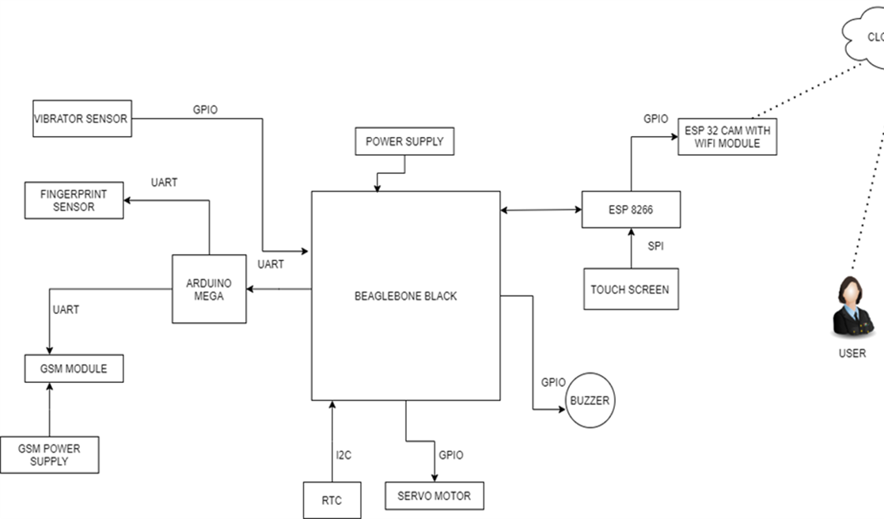
PROJECT OVERVIEW

Slide 4
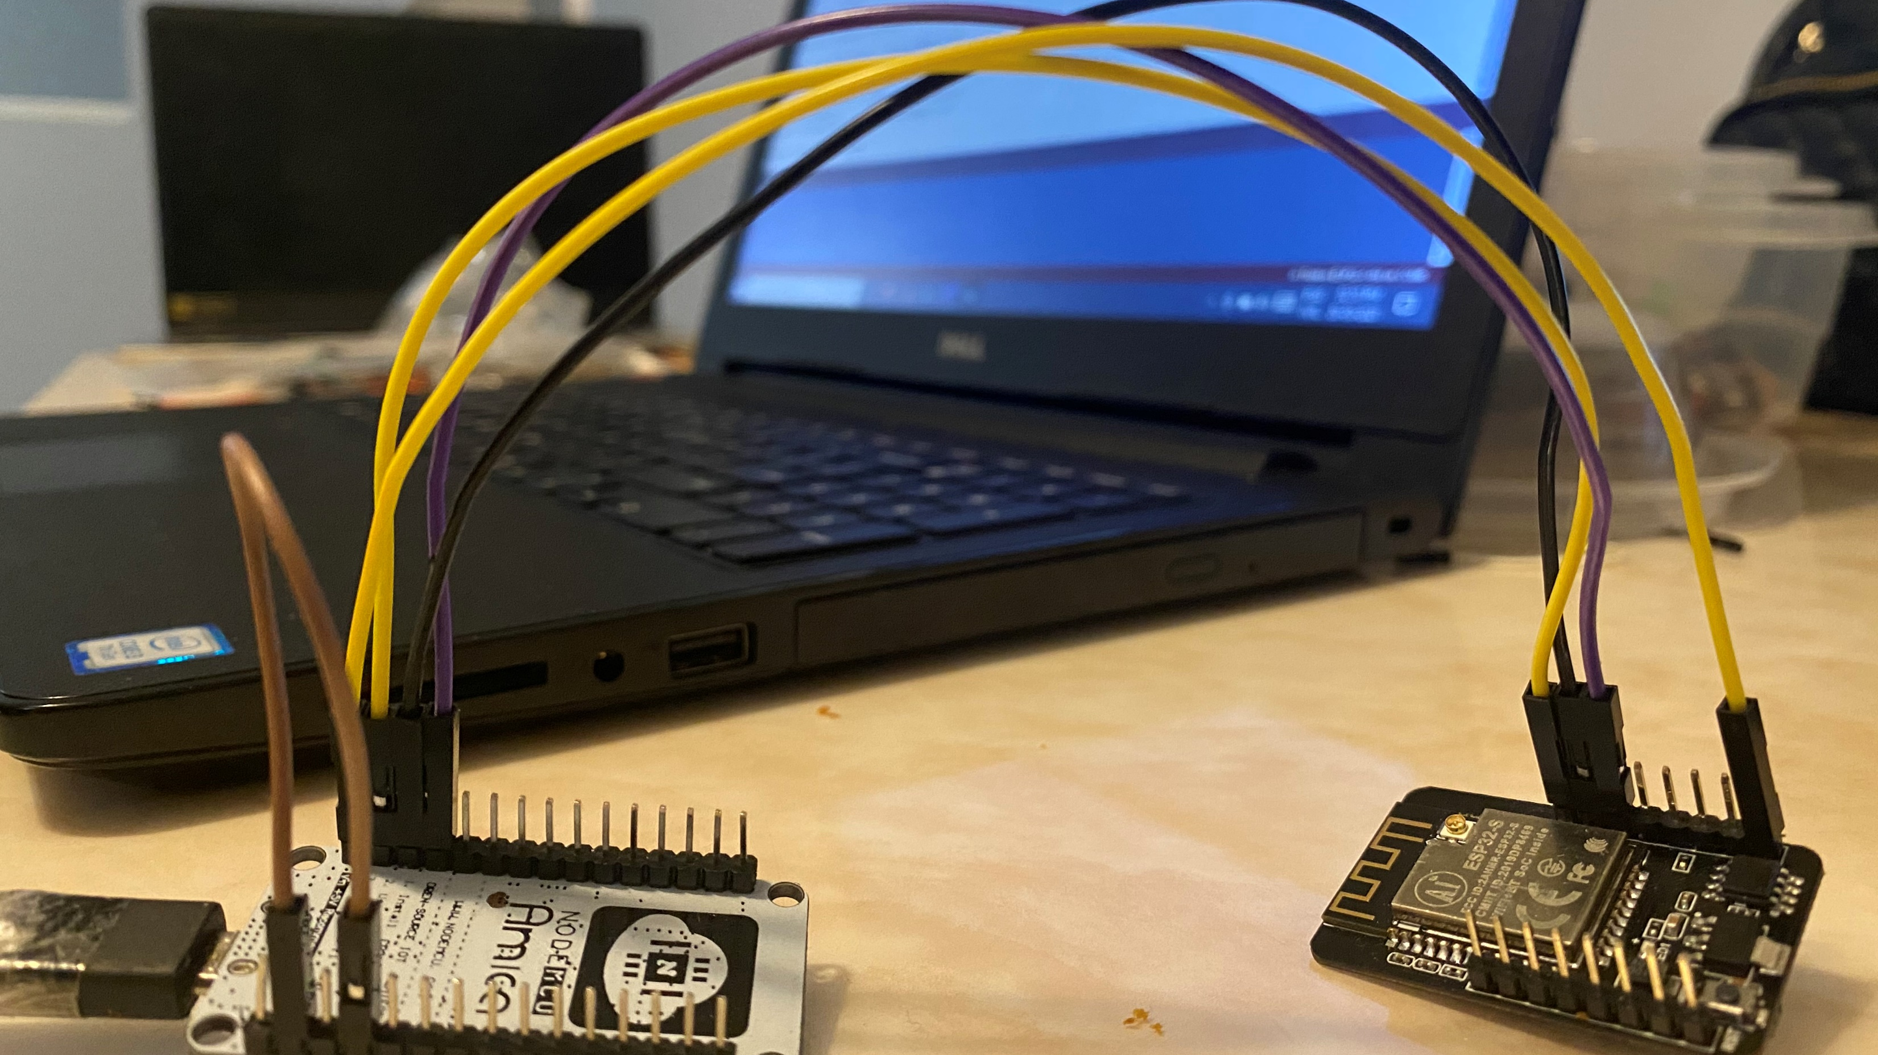
REQUIREMENTS
Task require both the hardware components and software.
Proper communication should be there between to accomplish the desired task.

Slide 5
HADWARE REQUIREMENTS
ESP32 CAM
ESP8266
USB CABLE
JUMPER WIRES

Slide 6

SOFTWARE REQUIREMENTS
ARDUINO IDE
This Photo by Unknown Author is licensed under CC BY-SA

Slide 7
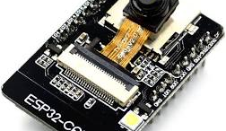
INTRODUCTION OF ESP32-CAM
The ESP32-CAM is a very small camera module with the ESP32-S chip . Besides the OV2640 camera, and several GPIOs to connect peripherals, it also features a microSD card slot that can be useful to store images taken with the camera or to store files to serve to clients.

Slide 8
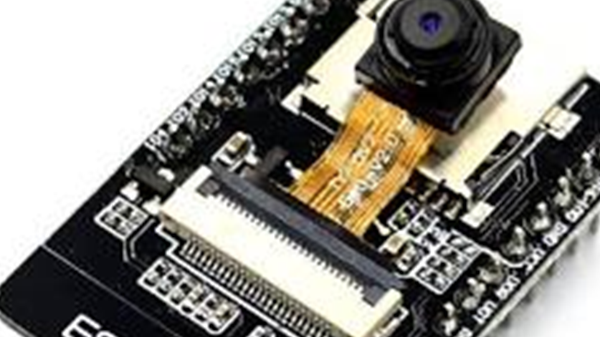
FEATURES
The smallest 802.11b/g/n Wi-Fi BT SoC module
Low power 32-bit CPU,can also serve the application processor
Up to 160MHz clock speed, summary computing power up to 600 DMIPS
Built-in 520 KB SRAM, external 4MPSRAM
Supports UART/SPI/I2C/PWM/ADC/DAC
Support OV2640 and OV7670 cameras
Support image WiFI upload
Embedded Lwip and FreeRTOS
Supports STA/AP/STA+AP operation mode

Slide 9
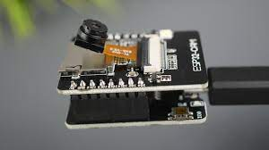
Working of ESP32- CAM
1) Go to Tools > Board and select AI-Thinker ESP32-CAM.
2) Go to Tools > Port and select the COM port the ESP32 is connected to.
3) Then, click the upload button to upload the code.
4) When you start to see these dots on the debugging window as shown below, press the ESP32-CAM on-board RST button.

Slide 10
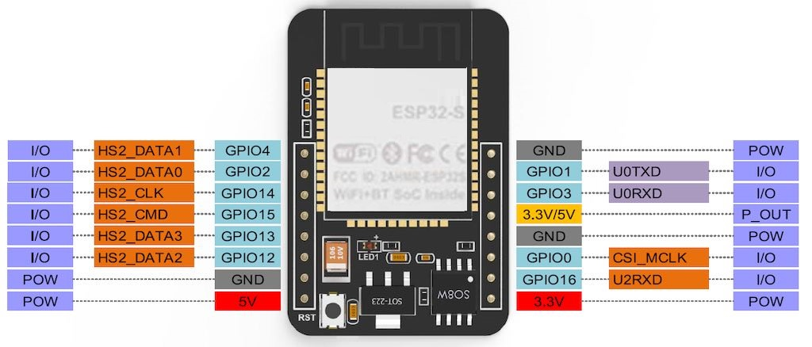
PIN DIAGRAM
This Photo by Unknown Author is licensed under CC BY-SA-NC

Slide 11
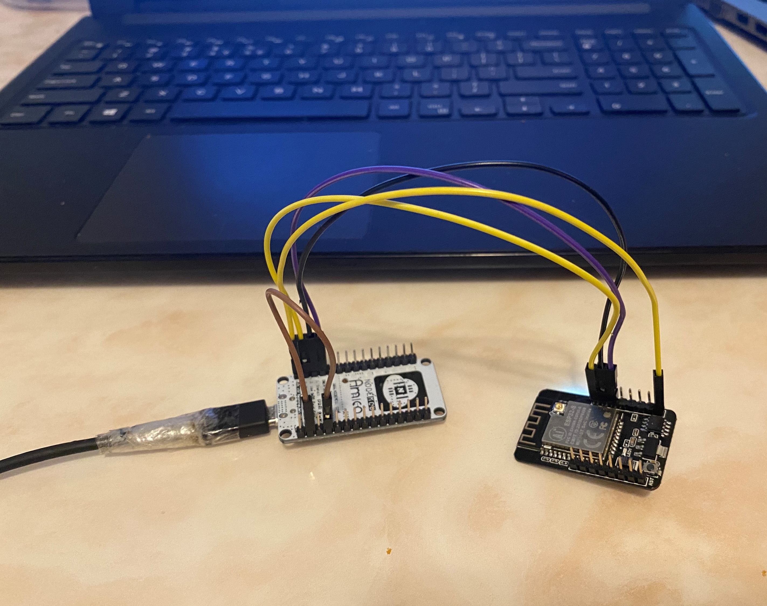
COMMUNICATION PROTOCOL USED COMMUNCommunication Protocol ATION PROTOCOL USED
The Simple Mail Transfer Protocol (SMTP) is an internet standard communication protocol for electronic mail transmission. Mail servers and other message transfer agents use SMTP to send and receive mail messages.

Slide 12
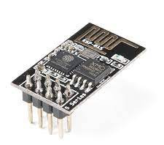
ESP8266
The ESP8266 is a low-cost Wi-Fi microchip, with a full TCP/IP stack and microcontroller capability, produced by Espressif Systems
This small module allows microcontrollers to connect to a Wi-Fi network and make simple TCP/IP connections
The ESP8285 is an ESP8266 with 1 MiB of built-in flash, allowing the building of single-chip devices capable of connecting to Wi-Fi

Slide 13
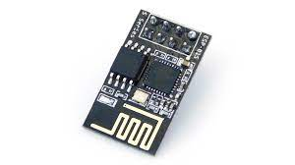
Working of ESP8266
Once Arduino IDE is installed on the computer, connect the board with the computer using the USB cable.
Now open the Arduino IDE and choose the correct board by selecting Tools>Boards>NodeMCU1.0 (ESP-12E Module)
Choose the correct Port by selecting Tools>Port.

Slide 14
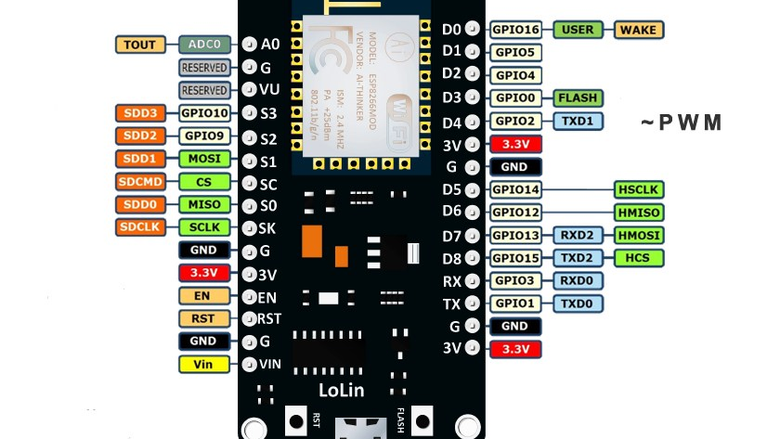
ESP 8266 PIN DISCRIPTION
This Photo by Unknown Author is licensed under CC BY-NC

Slide 15
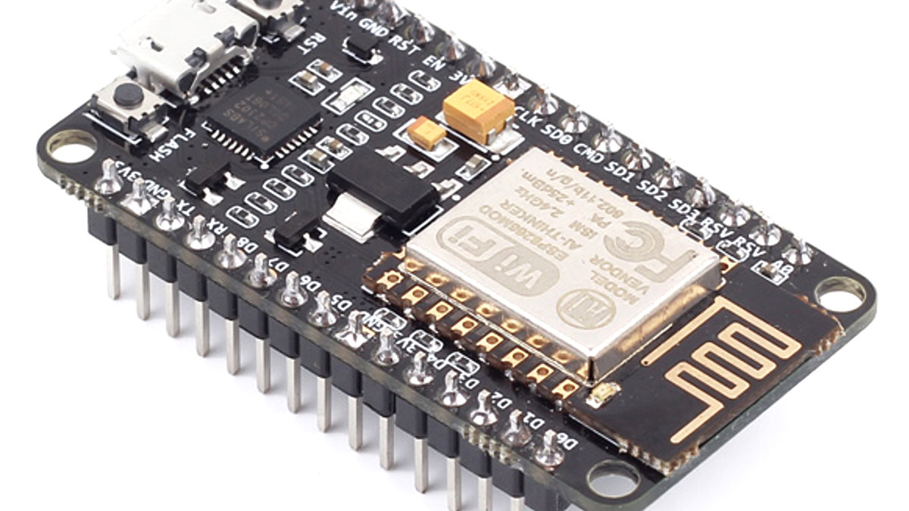
FEATURES
Operating Voltage: 3.3V
Input Voltage: 7-12V
Digital I/O Pins (DIO): 16
Analog Input Pins (ADC): 1
UARTs: 1
SPIs: 1
I2Cs: 1
Flash Memory: 4 MB
SRAM: 64 KB
Clock Speed: 80 MHz
USB-TTL based on CP2102 is included onboard, Enabling Plug n Play
PCB Antenna
Small Sized module to fit smartly inside your IoT projects
This Photo by Unknown Author is licensed under CC BY-SA

Slide 16
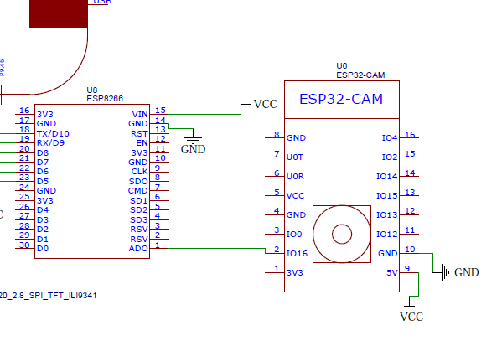
SCHEMATIC DIAGRAM

Slide 17
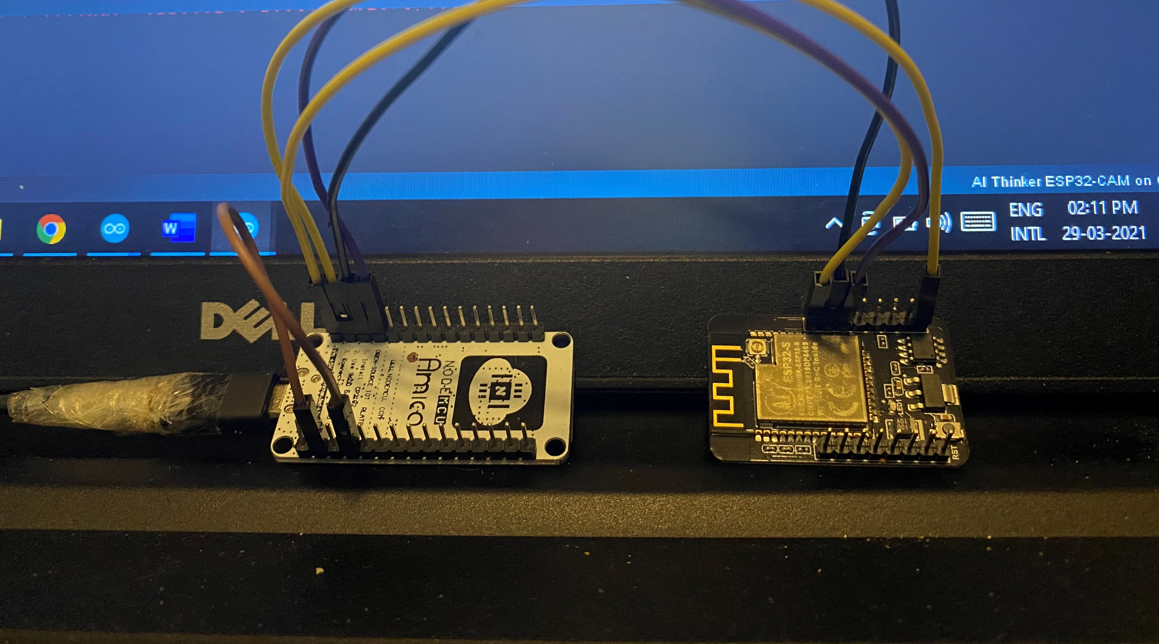
CONNECTIONS

Slide 18
PROGRAMMING ESP32 CAM
ESP 8266 | ESP32 CAM
Rx | UOR
Tx | UOT
GND | GND
Vin | 5V
ESP32-CAM is connected directly to the ESP8266 with the help of GPIO pins.

Slide 19
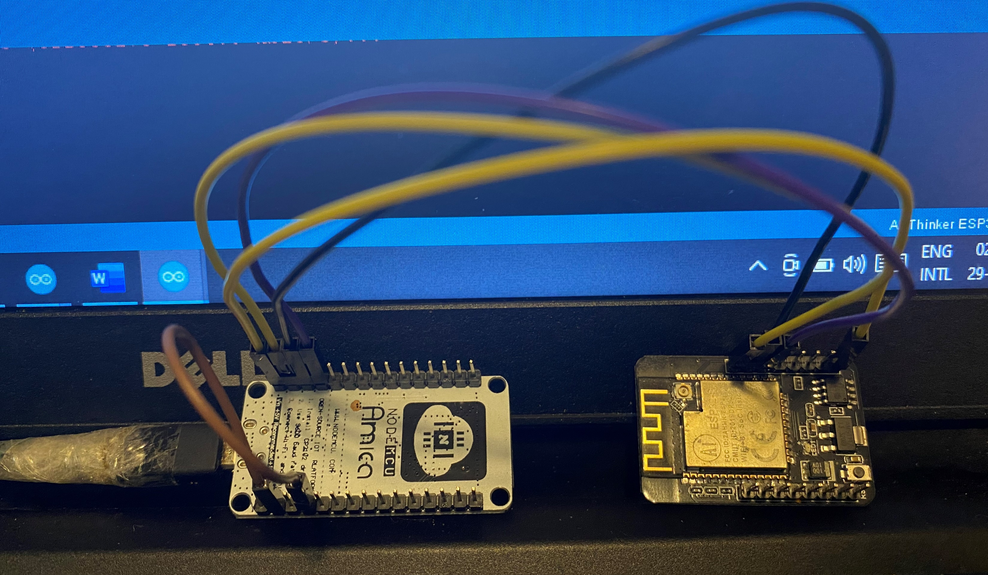
PROGRAMMING ESP32 CAM
ESP32CAM board does not support the usb cable communication.
So to upload the program in ESP32-CAM, ESP8266 is used.
GPIO Pin number 1 and 3 are used to upload the code on theESP32 cam.

Slide 20

PROGRAMMING ESP32 CAM
ESP 32 CAM should be in flashing mode and to do so we need to make following connection:
Connect EN pin and GND pin of ESP8266
Connect Io0 to GND pin of ESP32CAM

Slide 21

LIBRARIES USED IN INTERFACING
SPIFFS LIBRARY:
This library allows access to flash memory as if it were a normal file system like that of a computer. We can read, write and add data to a file and perform some simple operations (format, rename, retrieve information, etc.)
•ESP32_MailClient LIBRARY:
This library allows ESP32 to send Email with/without attachment and receive Email with/without attachment download through SMTP and IMAP servers.
•Wi-Fi LIBRARY:
This library allows an Arduino board to connect to the internet. It can serve as either a server accepting incoming connections or a client making outgoing ones.

Slide 22
LIBRARIES USED IN INTERFACING
EEPROM LIBRARY:
The microcontroller on the Arduino board has EEPROM: memory whose values are kept when the board is turned off (like a tiny hard drive). This library enables you to read and write those bytes.
•SD_MMC LIBRARY:
we will use the Arduino core library that allows to interact with the SD card.

Slide 23
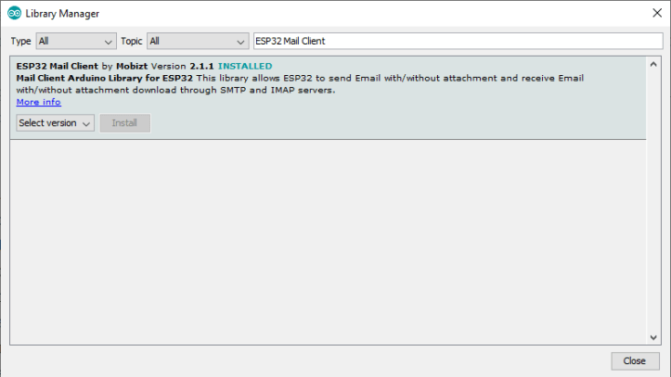
HOW TO INCLUDE THE LIBRARY??
In Arduino IDE go to Sketch > Include Library > Manage Libraries…

Slide 24
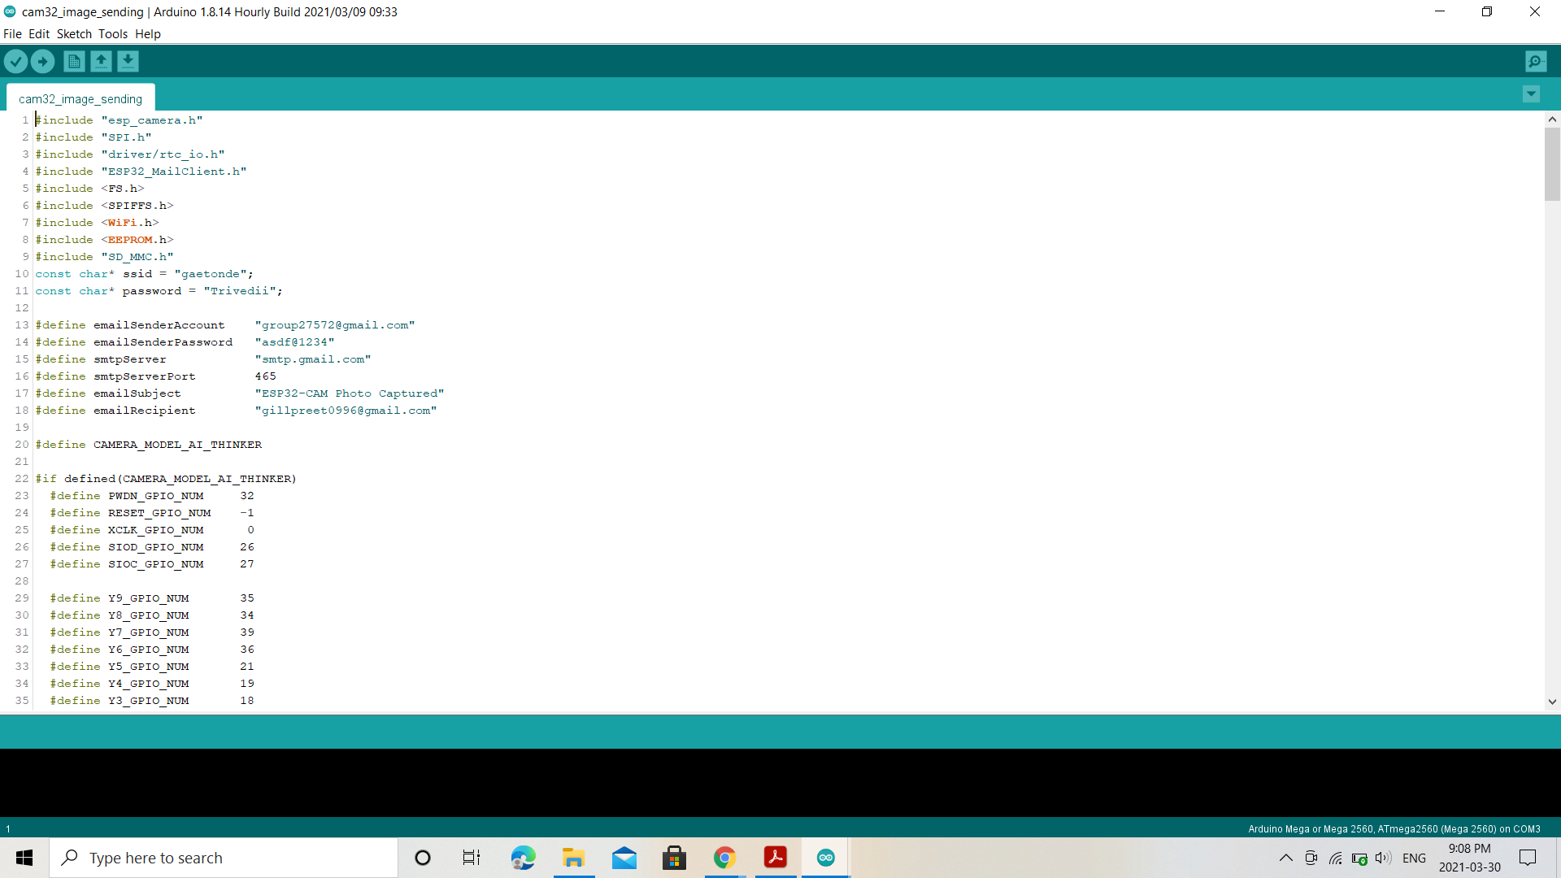
CODING
These are the libraries included
Email address of sender and user

Slide 25
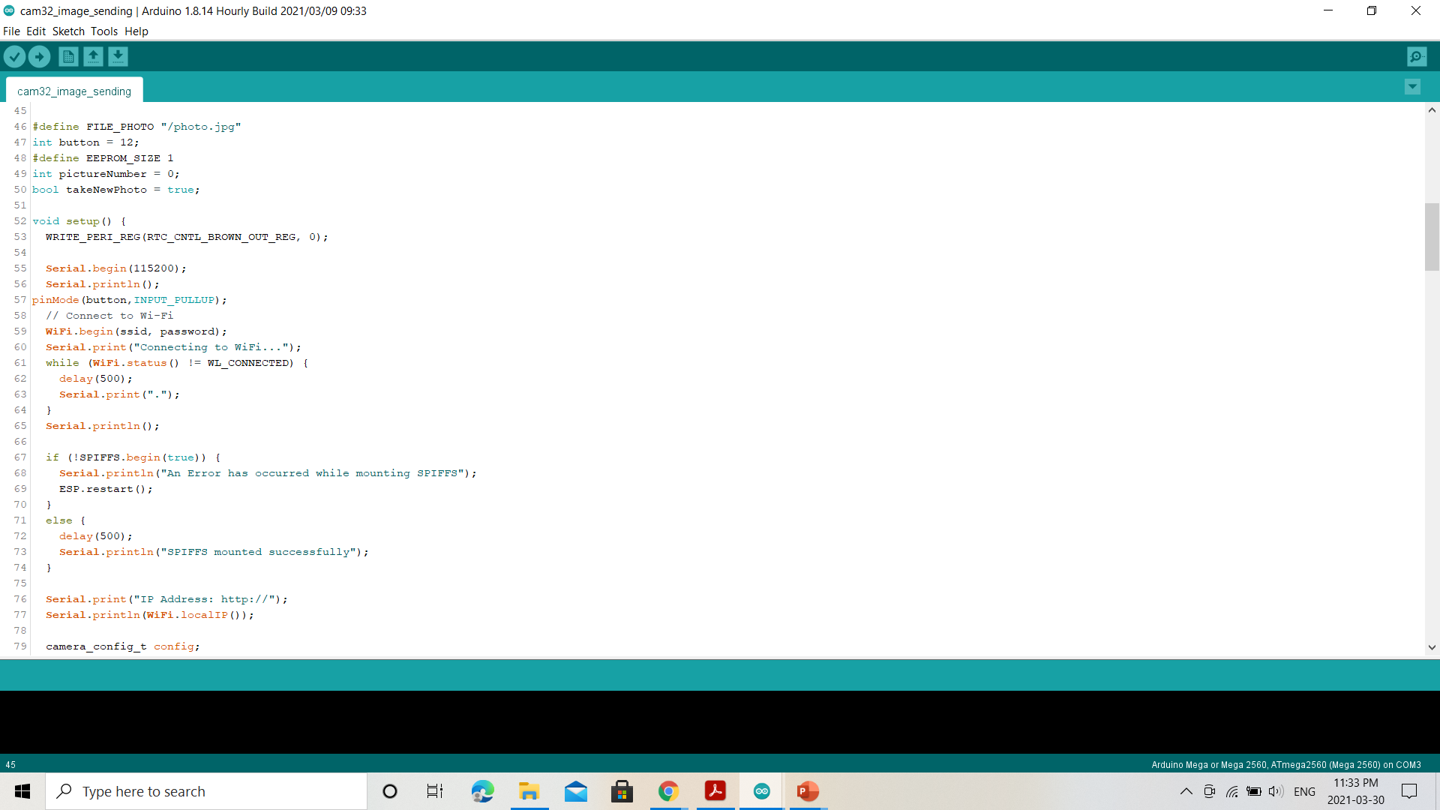
CODING
Picture format
For WIFI connectivity

Slide 26
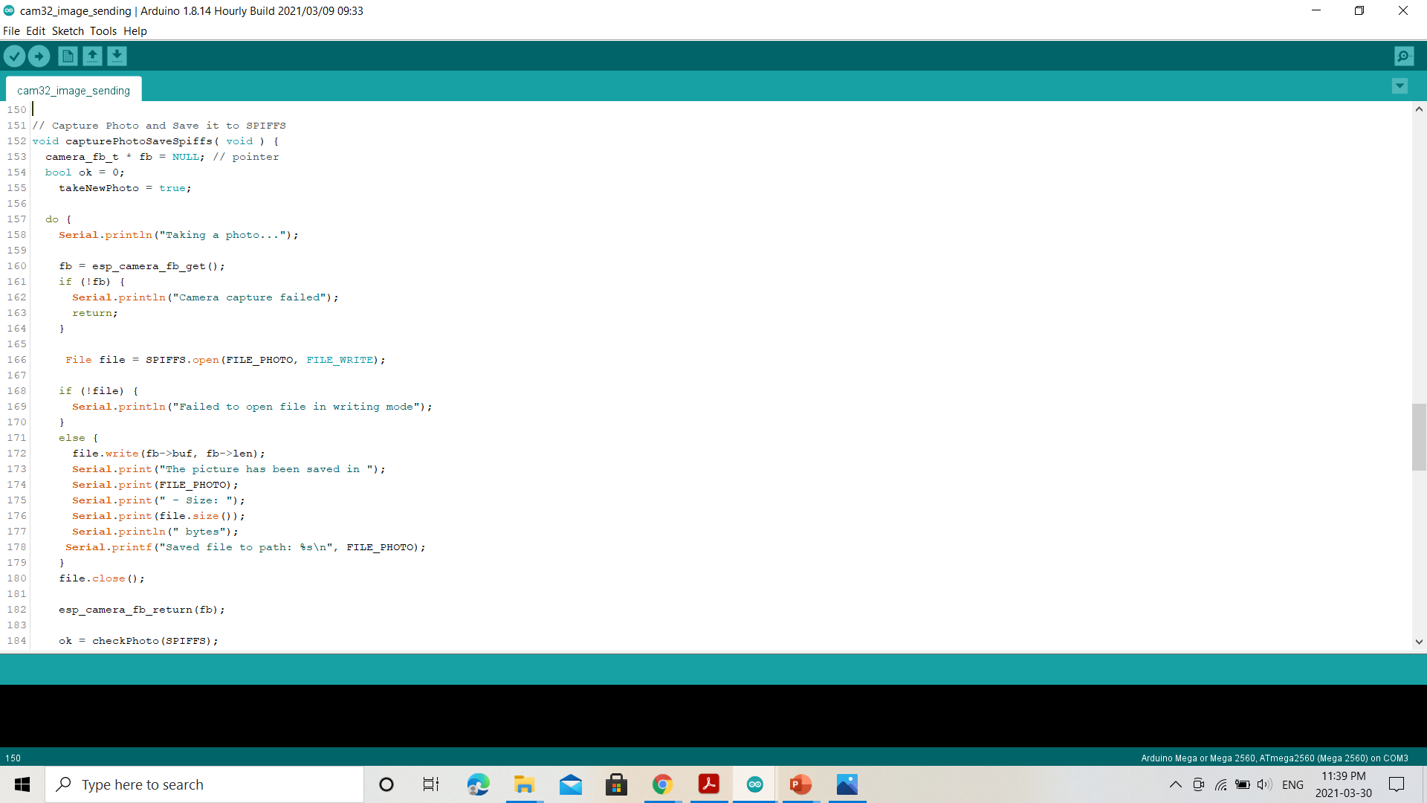
CODING
For capturing and saving the picture

Slide 27
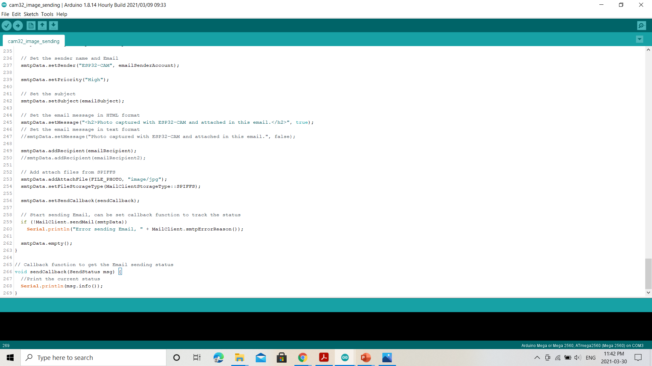
CODING

Slide 28
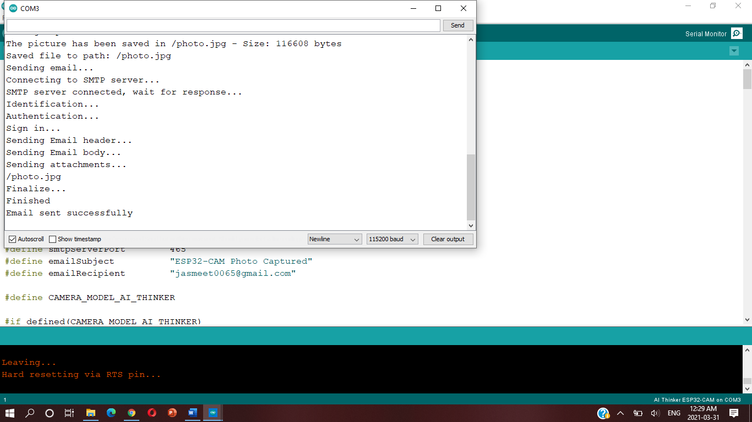
OUTPUT

Slide 29
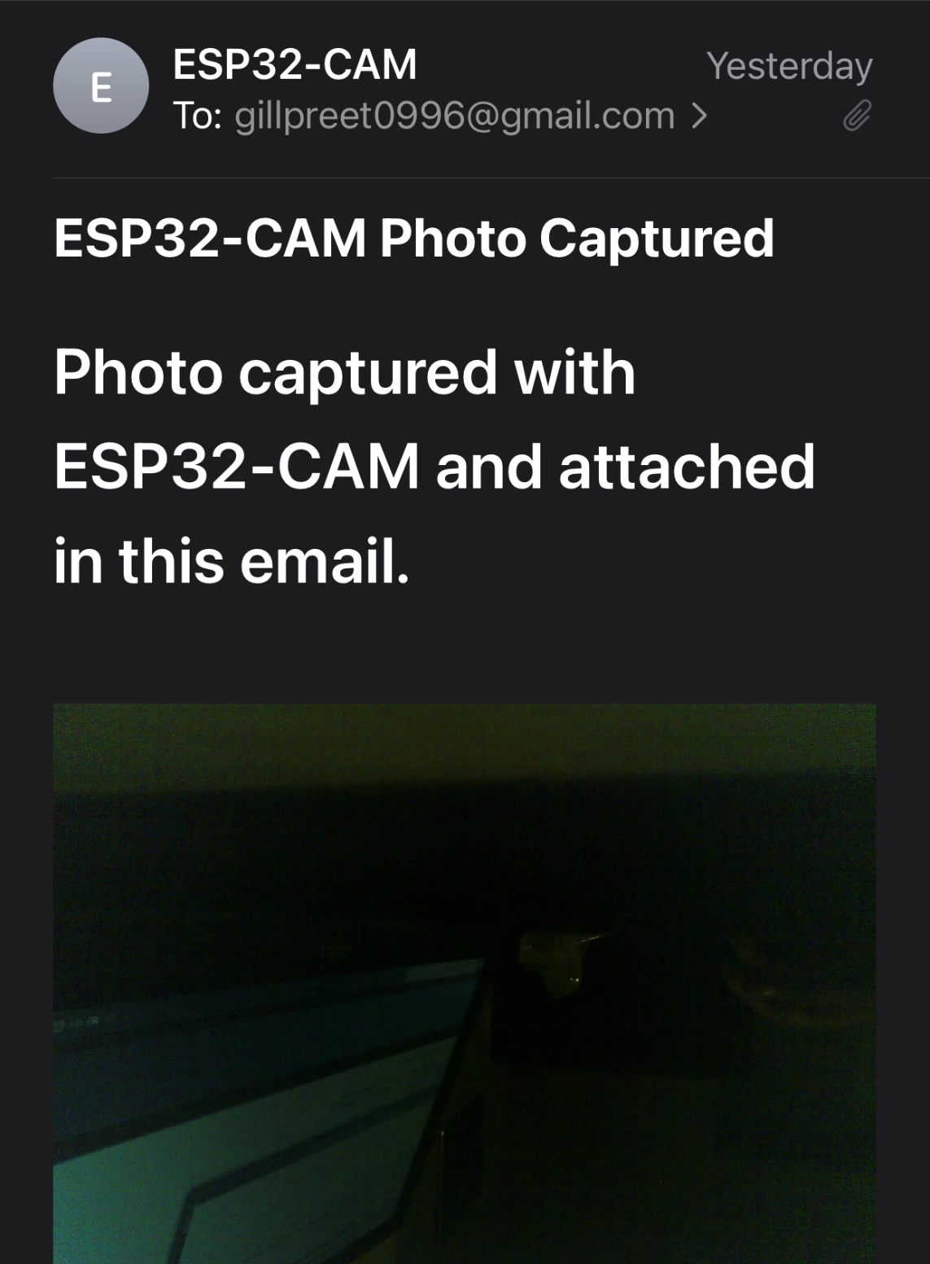
OUTPUT

Slide 30
REFERENCES
https://components101.com/development-boards/nodemcu-esp8266-pinout-features-and-datasheet
https://randomnerdtutorials.com/esp32-send-email-smtp-server-arduino-ide/
https://en.wikipedia.org/wiki/ESP8266

Slide 31

THANK YOU

